Slide 1

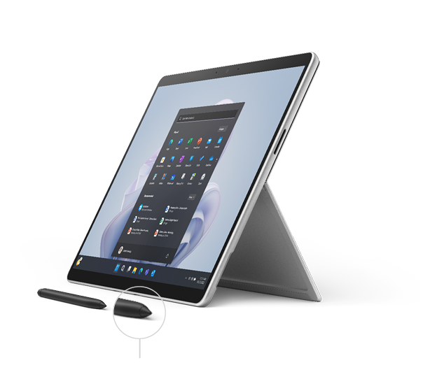
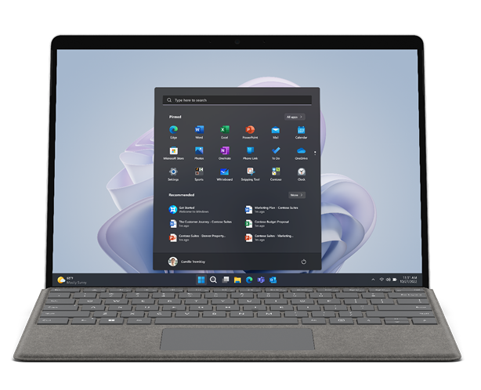




Microsoft Surface Pro 9
The most powerful Pro
The go everywhere, work anywhere, wherever the day takes your team, 2-in-1 that performs like a laptop: Microsoft Surface Pro 9. The Windows 11 Secured-core PC and virtually edge-to-edge 13” PixelSense™ touch display with
true-to-life color come together in a light, low-profile form to give your team the power they need for any path.
BENEFITS
Get pro-level performance and unlock workstation-class power with optional 12th Gen Intel® CoreTM processors built on the Intel® EvoTM platform and ThunderboltTM 4. |  | For employees on the go-go-go who need instant access, quick multitasking, and longer battery life, choose the latest generation Microsoft SQ® 3 processor. |  | Security has never been more important; it’s also never been easier with Surface Pro 9 and Microsoft SQ® 3. Pluton architecture secures sensitive data directly in the CPU, making it more difficult for attackers to access.
Select SKUs
built on the Intel® Evo™ Platform
Surface Slim Pen 2 is always ready with wireless charging built into Surface Pro 9 Signature Keyboard
Thunderbolt 4 port
Lightweight and
ultra-thin portability
at 1.98lbs
Adjust to the perfect angle with
the built-in kickstand
USB-C port

Slide 2
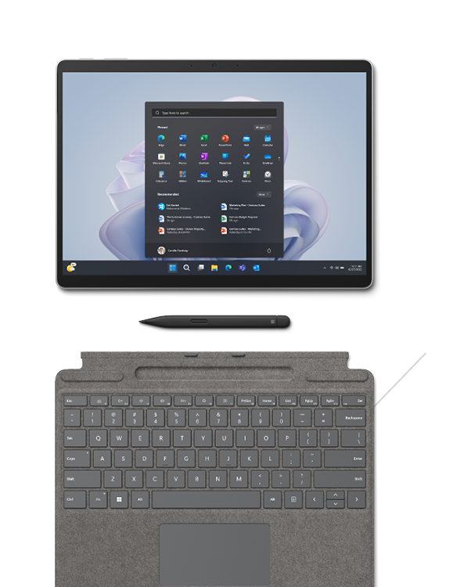





Microsoft Surface Pro 9
SIZE AND WEIGHT |  | Surface Pro 9 Length: 11.3 inch (287 mm) Width: 8.2 inch (209 mm) Height: 0.37 inch (9.3 mm) Weight⁵: 1.94lb (879 g) Surface Pro 9 with 5G Length: 11.3 inch (287 mm) Width: 8.2 inch (209 mm) Height: 0.37 inch (9.3 mm) Weight⁶: 1.95lb (883 g) (mmWave) or 1.94lb (878 g) (Sub6) |  | MEMORY¹ AND STORAGE |  | Surface Pro 9 Memory: 8GB, 16GB, 32GB (LPDDR5 RAM) Storage: Removable² drive (SSD) options: 128GB, 256GB, 512GB, 1TB Surface Pro 9 with 5G Memory: 8GB or 16GB LPDDR4x RAM Storage: Removable³ drive (SSD) options: 128GB, 256GB, 512GB
WHAT’S IN THE BOX |  | Surface Pro 9 Power Supply Quick Start Guide Safety and warranty documents Surface Pro 9 with 5G Power Supply Quick Start Guide Safety and warranty documents SIM Card access tool |  | RADIO FREQUENCY (FRANCE ONLY) |  | Surface Pro 9 Le débit d’absorption spécifique (DAS) local quantifie l’exposition de l’utilisateur aux ondes électromagnétiques de l’équipement concerné. Le DAS maximal autorisé est de 0,911 W/kg pour le tronc et de 1,674 W/kg pour les membres Surface Pro 9 with 5G Le débit d’absorption spécifique (DAS) local quantifie l’exposition de l’utilisateur aux ondes électromagnétiques de l’équipement concerné. Le DAS maximal autorisé est de 1.48 W/kg pour le tronc et de 1.48 W/kg pour les membres
Choice of vibrant colors. Mix and match with a Surface Pro Signature Keyboard* in new Sapphire and Forest,³⁵ made with partially biobased Alcantara® material containing at least 12% renewable content³⁵ that is
derived from sugarcane waste
Platinum
Graphite
Sapphire
Forest
An everyday, everywhere laptop when
paired with Surface Pro Keyboard

Slide 3
Microsoft Surface Pro 9
NETWORK AND Connectivity |  | Surface Pro 9 Wi-Fi 6E: 802.11ax compatible Bluetooth® Wireless 5.1 technology Surface Pro 9 with 5G Wi-Fi 6E: 802.11ax compatible Bluetooth® Wireless 5.1 technology Location: GPS, Glonass, Galileo and Beidou Support NanoSIM and eSIM¹⁰ support Supports 5G¹¹ [mmWave markets only]: 5G-NR NSA (mmWave): Release 15 DL 64 QAM up to 4.2 Gbps 4xDL CA (400MHz), 2x2 MIMO 5G-NR NSA (mmWave): Release 15 UL 64 QAM, 2xUL CA (200MHz), 2x2 MIMO 5G-NR NSA (mmWave) Bands: n257, n260, n261 [Sub-6 markets only]: 5G-NR NSA (Sub-6): Release 15 DL 256 QAM up to 2.8 Gbps , 4x4 MIMO 5G-NR NSA (Sub-6): Release 15 UL 256 QAM 5G-NR NSA (Sub-6) Bands: n1, n2, n3, n5, n7, n8, n20, n25, n28, n38, n40, n41, n66, n71, n77, n78, n79 Gigabit LTE - A Pro Release 15 with 4x4 MIMO and LAA LTE DL Cat 20, 256 QAM up to 2Gbps, 5xDL CA LTE UL Cat 13, 64 QAM Contiguous 2X ULCA LTE Bands: 1, 2, 3, 4, 5, 7, 8, 12, 13, 14, 19, 20, 25, 26, 28, 29, 30, 38, 39, 40, 41, 42, 46, 48, 66, 71 WCDMA: 1,2,5,8 |  | display |  | Surface Pro 9 Screen: 13” PixelSense™ Flow Display Resolution: 2880 X 1920 (267 PPI) Color profile: sRGB and Vivid Refresh rate up to 120Hz (Dynamic refresh rate supported) Aspect ratio: 3:2 Contrast ratio 1200:1 Adaptive Color Auto Color Management supported Touch: 10-point multi-touch Dolby Vision IQ™ support⁴ Gorilla® Glass 5 Brightness: 450 nits maximum (typical), 2 nits minimum Surface Pro 9 with 5G Screen: 13” PixelSense™ Flow Display Resolution: 2880 X 1920 (267 PPI) Color profile: sRGB and Vivid Dynamic refresh rate up to 120Hz Aspect ratio: 3:2 Contrast: 1200:1 Adaptive Color Touch: 10-point multi-touch Gorilla® Glass 5 Brightness: 450 nits maximum (typical), 5 nits minimum
exterior |  | Surface Pro 9 Casing: Aluminum Colors³⁵: Platinum, Graphite, Sapphire, Forest Physical Buttons: Volume, Power Surface Pro 9 with 5G Casing: Aluminum Colors: Platinum Physical Buttons: Volume, Power |  | Battery capacities |  | Surface Pro 9 Battery Capacity Nominal (WH) 47.7 Wh Battery Capacity Min (WH) 46.5 Wh Surface Pro 9 with 5G Battery Capacity Nominal (WH) 47.7Wh Battery Capacity Min (WH) 46.5Wh

Slide 4
Microsoft Surface Pro 9
serviceAbility³⁴ |  | Replaceable components include Display Battery Surface Connect Port Thermal Module (Surface Pro 9 with 5G only) Thermal Module with Fan (Surface Pro 9 only) Cameras Speakers Buttons Camera Deck (Surface Pro 9 with 5G only) Wi-Fi Deck (Surface Pro 9 only) Back Cover Removable SSD Removable SSD Door Kickstand Motherboard |  | Pen and accessories compatibility |  | Surface Pro 9 Designed for Surface Slim Pen 2¹² Integrated storage and wireless charging for Surface Slim Pen 2¹³ with Surface Pro Signature Keyboard* Supports tactile signals¹⁴ with Surface Slim Pen 2¹⁵ Supports Microsoft Pen Protocol (MPP) Surface Pro 9 with 5G Designed for Surface Slim Pen 2¹⁶ Integrated storage and wireless charging for Surface Slim Pen 2¹⁷ with Surface Pro Signature Keyboard Supports tactile signals¹⁸ with Surface Slim Pen 2¹⁹ Supports Microsoft Pen Protocol (MPP) Keyboard Compatibility Surface Pro Signature Keyboard Surface Pro Keyboard Surface Pro X Signature Keyboard Surface Pro X Keyboard
sustainability³¹ |  | Surface Pro 9 Meets ENERGY STAR® requirements Registered EPEAT® Gold in the US and Canada³² Sustainable Products & Solutions | Microsoft CSR Surface Pro 9 with 5G: Meets ENERGY STAR® requirements Registered EPEAT® Gold in the US and Canada³³ Sustainable Products & Solutions | Microsoft CSR |  | cameras |  | Surface Pro 9 Windows Hello face authentication camera (front-facing) Front-facing camera with 1080p full HD video 10.0MP rear-facing autofocus camera with 1080p HD and 4k video Surface Pro 9 with 5G Windows Hello face authentication camera (front-facing) Front-facing camera with 1080p full HD video 10.0 MP rear-facing autofocus camera with 1080p HD and 4k video
BATTERY LIFE |  | Surface Pro 9⁷ Up to 15.5 hours of typical device usage Surface Pro 9 with 5G⁸ Up to 19 hours of typical device usage |  | graphics |  | Surface Pro 9 Intel® Iris® Xe graphics Surface Pro 9 with 5G Microsoft SQ® 3 Adreno™ 8CX Gen 3

Slide 5
Microsoft Surface Pro 9
SOFTWARE |  | Surface Pro 9 Windows 11 Pro or Windows 10 Pro Preloaded Microsoft 365 Apps²³ Microsoft 365 Business Standard, Microsoft 365 Business Premium, or Microsoft 365 Apps 30-day trial Surface Pro 9 with 5G Windows 11 Pro on ARM²⁸ Preloaded Microsoft 365 Apps²⁹ Microsoft 365 Business Standard, Microsoft 365 Business Premium, or Microsoft 365 Apps 30-day trial³⁰ |  | SECURITY |  | Surface Pro 9 TPM 2.0 chip for enterprise-grade security and BitLocker support Enterprise-grade protection with Windows Hello face sign-in Windows 11 Secured-core PC Surface Pro 9 with 5G Enhanced security with Microsoft Pluton Enterprise-grade protection with Windows Hello face sign-in Windows 11 Secured-core PC
SENSORS |  | Accelerometer Gyroscope Magnetometer Ambient Color Sensor (Brightness and Color) |  | AUDIO |  | Surface Pro 9 Dual far-field Studio Mics 2W stereo speakers with Dolby® Atmos®⁹ Surface Pro 9 with 5G Dual far-field Studio Mics 2W stereo speakers
ACCESSIBILITY |  | Compatible with Surface Adaptive Kit Compatible with Surface Delray Include Windows Accessibility Feature – Learn More Accessibility Features | Microsoft Accessibility Discover more Microsoft Accessible Devices & Products - Accessible Devices & Products for PC & Gaming | Assistive Tech Accessories - Microsoft Store |  | ENERGY USAGE (JAPAN ONLY) |  | Surface Pro 9 エネルギー消費効率 Surface Pro 9 構成：12区分 16.4kWh/年(AAA) (2022年度省エネ達成率) Surface Pro 9 with 5G エネルギー消費効率 Surface Pro 9 構成：12区分 10.8kWh/年(AAA) (2022年度省エネ達成率)
PROCESSOR |  | Surface Pro 9 12th Gen Intel® Core™ i5-1245U processor 12th Gen Intel® Core™ i7-1265U processor Options with storage 256 GB and above built on the Intel® Evo™ platform Surface Pro 9 with 5G Microsoft SQ® 3 processor Neural Processing Unit (NPU) |  | PORTS |  | Surface Pro 9 2 x USB-C® with USB 4.0/Thunderbolt™ 4 1 x Surface Connect port 1 x Surface Keyboard port Surface Pro 9 with 5G 1 x nano SIM 2 x USB-C® 3.2 1 x Surface Connect port 1 x Surface Keyboard port
WARRANTY³⁶ |  | 1-year limited hardware warranty

Slide 6
Microsoft Surface Pro 9
Disclaimers
1 System software uses significant storage space. Available storage is subject to change based on system software updates and apps usage. 1 GB = 1 billion bytes. 1 TB = 1,000 GB.
See Surface.com/Storage for more details.
2 Components available through your Surface Commercial Authorized Device Reseller. Components can be replaced on-site by a skilled technician following Microsoft’s Service Guide. Microsoft tools (sold separately) may also be required for repair. Opening and/or repairing your device can present electric shock, fire and personal injury risk and other hazards. Use caution if undertaking do-it-yourself repairs. Device damage caused during repair will not be covered under Microsoft’s Hardware Warranty or protection plans.
3 Components available through your Surface Commercial Authorized Device Reseller. Components can be replaced on-site by a skilled technician following Microsoft’s Service Guide. Microsoft tools (sold separately) may also be required for repair. Opening and/or repairing your device can present electric shock, fire and personal injury risk and other hazards. Use caution if undertaking do-it-yourself repairs. Device damage caused during repair will not be covered under Microsoft’s Hardware Warranty or protection plans.
4 Requires Dolby Vision® encoded content and video.
5 Weight not including Surface Pro Signature Keyboard and Surface Slim Pen 2 (sold separately).
6 Weight not including Surface Pro Signature Keyboard and Surface Slim Pen 2 (sold separately).
7 Surface Pro 9: Up to 15.5 hours of battery life based on typical Surface device usage. Testing conducted by Microsoft in August 2022 using preproduction software and preproduction Intel®12th Gen Core™ i5, 256GB, 8GB RAM device. Testing consisted of full battery discharge with a mixture of active use and modern standby. The active use portion consists of (1) a web browsing test accessing eight popular websites over multiple open tabs, (2) a productivity test utilizing Microsoft Word, PowerPoint, Excel, OneNote and Outlook, and (3) a portion of time with the device in use with idle applications. All settings were default except screen brightness was set to 150 nits with Auto-Brightness and Adaptive Color disabled. Wi-Fi was connected to a network. Tested with Windows Version 11.0.22621 (21H2). Battery life varies significantly with settings, usage and other factors.
8 Surface Pro 9 with 5G Wi-Fi: Up to 19 hours of battery life based on typical Surface device usage. Testing conducted by Microsoft in August 2022 using preproduction software and preproduction SQ® 3, 128/256/512GB, 8/16GB RAM device. Testing consisted of full battery discharge with a mixture of active use and modern standby. The active use portion consists of (1) a web browsing test accessing eight popular websites over multiple open tabs, (2) a productivity test utilizing Microsoft Word, PowerPoint, Excel, OneNote and Outlook, and (3) a portion of time with the device in use with idle applications. All settings were default except screen brightness was set to 150 nits with Auto-Brightness and Adaptive Color disabled. Wi-Fi was connected to a network. Tested with Windows Version 11.0.22621 (21H2). Battery life varies significantly with settings, usage and other factors.
9 Requires Dolby Atmos® encoded content and video.
10 eSIM support may vary by carrier. Individual device activation for eSIM is supported, however bulk activations leveraging eSIM on devices with Windows 10 are not currently available. [China only: Remove eSIM from specs and disclaimer as eSIM is not offered in China]
11 5G not available in all areas, mmWave in US only. Supports Sub-6 GHz, not available in all areas; compatibility and performance depend on carrier network, plan and other factors. See carrier for details and pricing.
12 Sold separately
13 Sold separately. Software license required for some features. Charger for Surface Slim Pen 2 sold separately. Surface Slim Pen 2 can charge with Surface Slim Pen Charger, Surface Pro Signature Keyboard, Surface Pro X Signature Keyboard, Surface Laptop Studio, and Surface Duo 2 Pen Cover.
14 Tactile signals with Surface Slim Pen 2 can be experienced on some applications on Surface B&P running Windows 11.
15 Surface Slim Pen 2 sold separately.
16 Sold separately
17 Sold separately. Software license required for some features. Charger for Surface Slim Pen 2 sold separately. Surface Slim Pen 2 can charge with Surface Slim Pen Charger, Surface Pro Signature Keyboard, Surface Pro X Signature Keyboard, Surface Laptop Studio, and Surface Duo 2 Pen Cover.
18 Tactile signals with Surface Slim Pen 2 can be experienced on some applications on Surface B&P running Windows.
19 Surface Slim Pen 2 sold separately.
23 Activation required. If your device is managed by your organization’s IT department, contact your IT administrator for activation. After 30 days, you will be charged the applicable monthly or annual subscription fee. Credit card required. Cancel any time to stop future charges. See https://aka.ms/m365businesstrialinfo.
28 Surface Pierce comes with Windows 11 Pro on ARM At this time, Surface Pierce with Windows 11 Pro on ARM will not install some games and CAD software, and some third-party drivers or anti-virus software. Certain features require specific hardware (see aka.ms/windows11-spec). Find out more in the FAQ
29 Activation required. If your device is managed by your organization’s IT department, contact your IT administrator for activation. After 30 days, you will be charged the applicable monthly or annual subscription fee. Credit card required. Cancel any time to stop future charges. See https://aka.ms/m365businesstrialinfo.
30 Activation required. If your device is managed by your organization’s IT department, contact your IT administrator for activation. After 30 days, you will be charged the applicable monthly or annual subscription fee. Credit card required. Cancel any time to stop future charges. See https://aka.ms/m365businesstrialinfo.
31 Download the full Eco profile see – link to be provided post GA
32 For more information on registration in other markets check – link to be provided post GA
33 For more information on registration in other markets check – link to be provided post GA
34 Customer Replaceable Units (CRUs) are components available for purchase through your Surface Commercial Authorized Device Reseller. Components can be replaced on-site by a skilled technician following Microsoft’s Service Guide. Opening and/or repairing your device can present electric shock, fire and personal injury risks and other hazards. Use caution if undertaking do-it-yourself repairs. Device damage caused during repair will not be covered under Microsoft’s Hardware Warranty or protection plans. Components will be available shortly after initial launch; timing of availability varies by component and market.
35 Colors available on selected models only. Available colors, sizes, finishes, and processors may vary by store, market, and configuration.
36 Microsoft’s Limited Warranty is in addition to your consumer law rights.
37 [France only] Le débit d'absorption spécifique (DAS) local quantifie l'exposition de l'utilisateur aux ondes électromagnétiques de l'équipement concerné. Le DAS maximal autorisé est de 2 W/kg pour la tête et le tronc et de 4 W/kg pour les membres. Consultez cette page pour en savoir plus.

